Slide 1
How Does ChatGPT Work? An Overview of Large Language Models

Slide 2
Part I: How to build a Large Language Model (LLM)

Slide 3
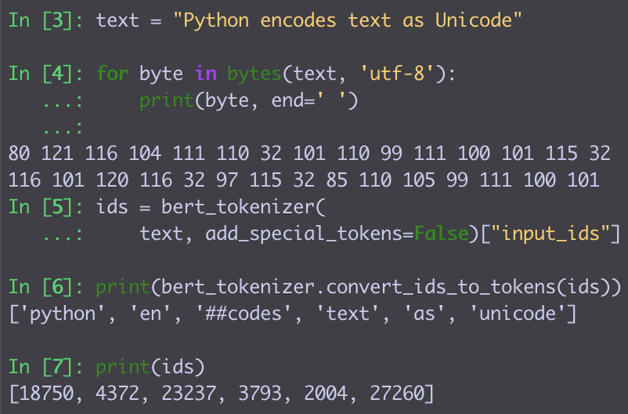
Representing Natural Language in Machines
Strings:
Each character is 1-2 bytes
Great for text manipulations
Concatenate, Find + Replace
No semantics or morphology
Tokens:
Map each word to a token ID
In practice:
Some words are too rare / misspelled
Split these into common word parts and map these to IDs

Slide 4
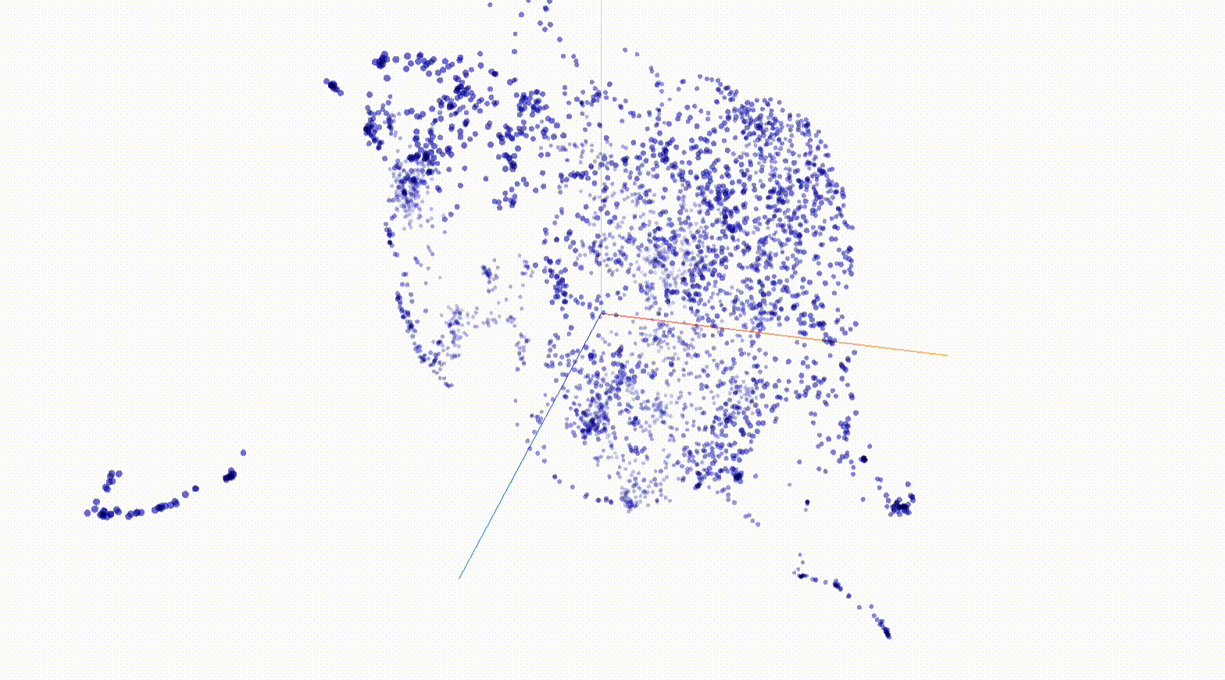
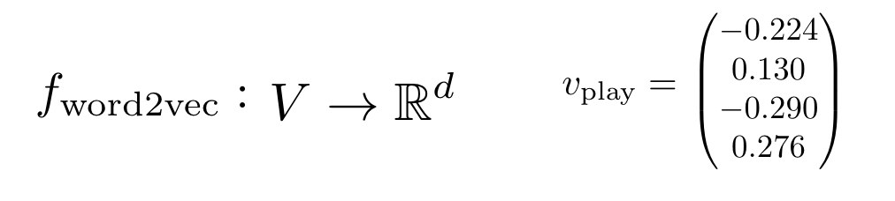
Representing Natural Language in Neural Networks
Word embeddings:
≈ 100–1000 dims!
…..
Models can learn
similar words ≈ similar vectors
in many possible directions.

Slide 5
Modeling Natural Language
Language Models: Assign a probability to any sequence of tokens.
e.g. p(dog) > p(turtle)
10⁻⁴ 10⁻⁶
p(a turtle swims in the ocean) > p(a dog swims in the ocean)
10⁻¹¹ 10⁻¹³
Left-to-right language models:
p(a turtle swims in the ocean) = p(a)
p(turtle | a)
p(swims | a turtle)
p(in | a turtle swims)
p(the | a turtle swims in)
p(ocean | a turtle swims in the)

Slide 6
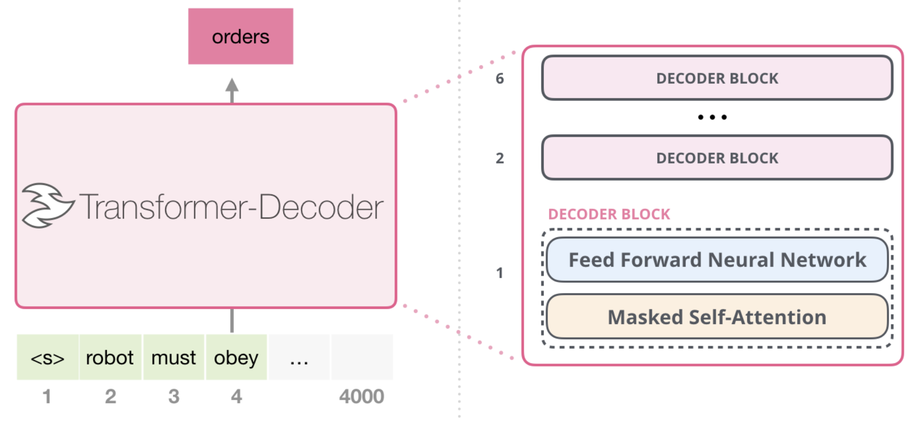
The Transformer Architecture:
How to model p(next token | previous tokens)?
≈ 10–100
layers
[from Alammar, The Illustrated GPT-2, https://jalammar.github.io/illustrated-gpt2/]

Slide 7
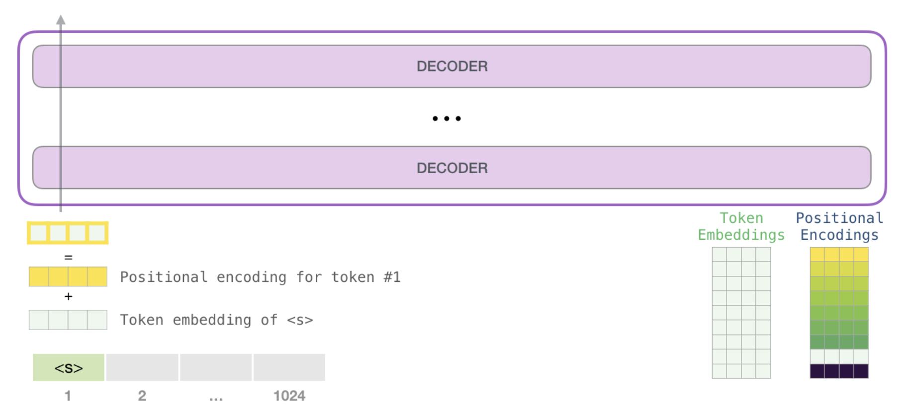
The Transformer Architecture:
Embedding Layer
[from Alammar, The Illustrated GPT-2, https://jalammar.github.io/illustrated-gpt2/]

Slide 8
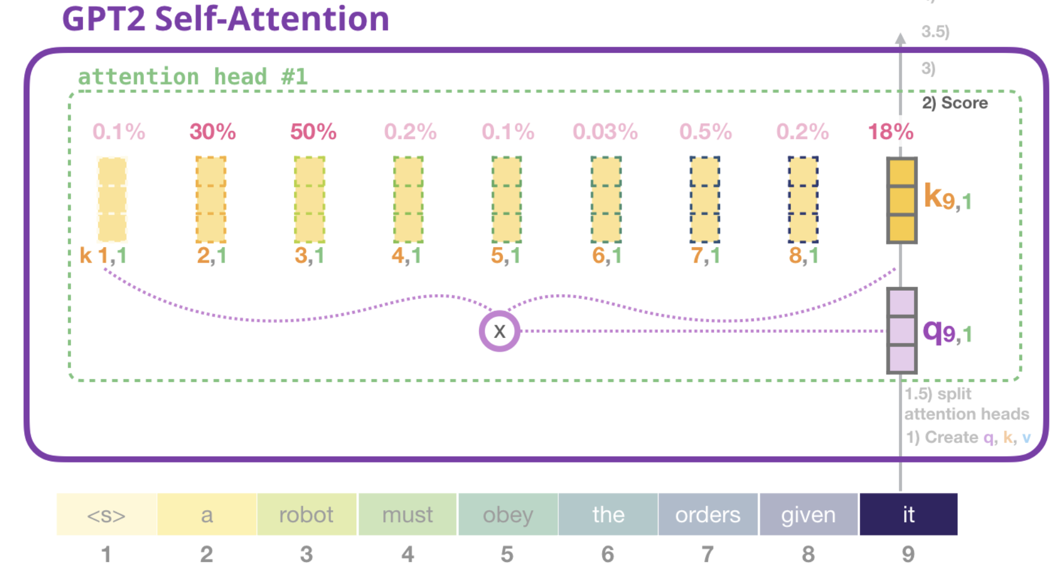
The Transformer Architecture:
Attention Layer
⇒ Integrates information from previous tokens
⇒ Can perform operations like lookup or copy
[from Alammar, The Illustrated GPT-2, https://jalammar.github.io/illustrated-gpt2/]

Slide 9
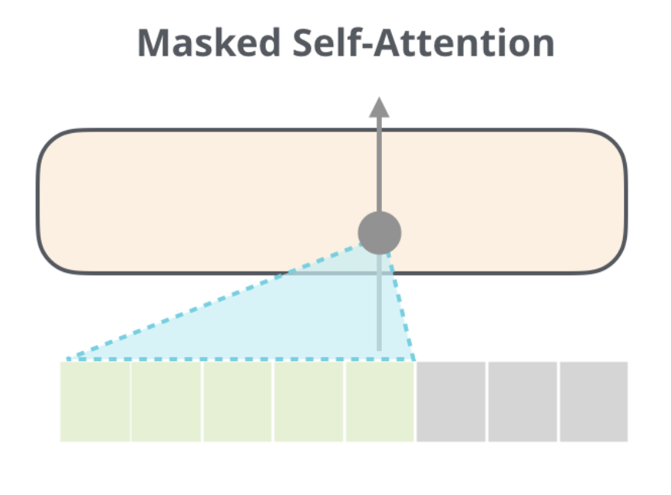
The Transformer Architecture:
Attention Layer
⇒ Don’t attend to future tokens
[from Alammar, The Illustrated GPT-2, https://jalammar.github.io/illustrated-gpt2/]

Slide 10
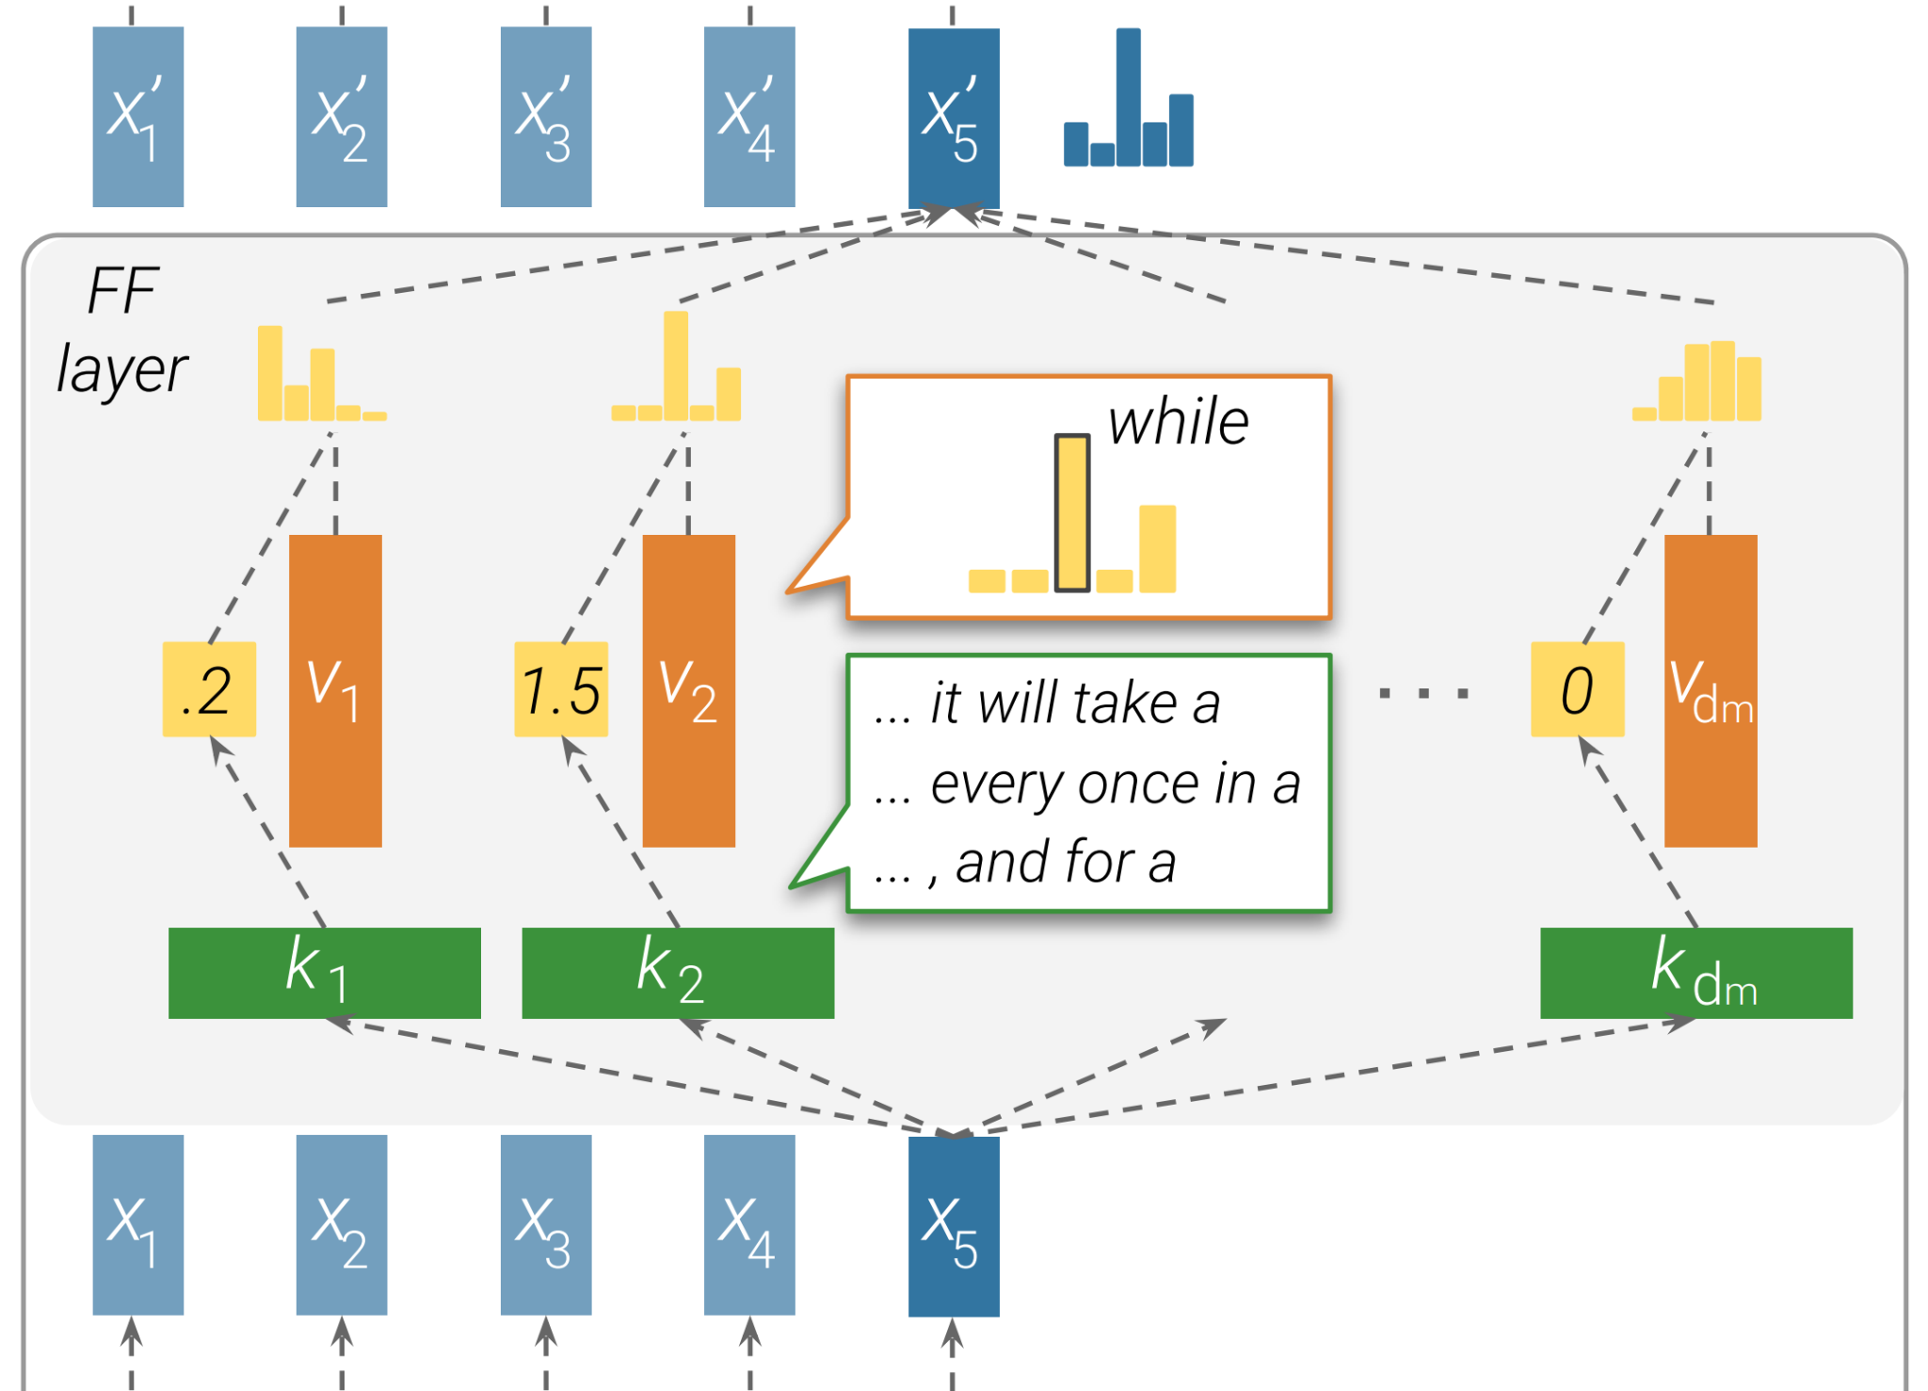
The Transformer Architecture:
Feed-forward Layer
⇒ Store knowledge as a dictionary between embeddings

Slide 11
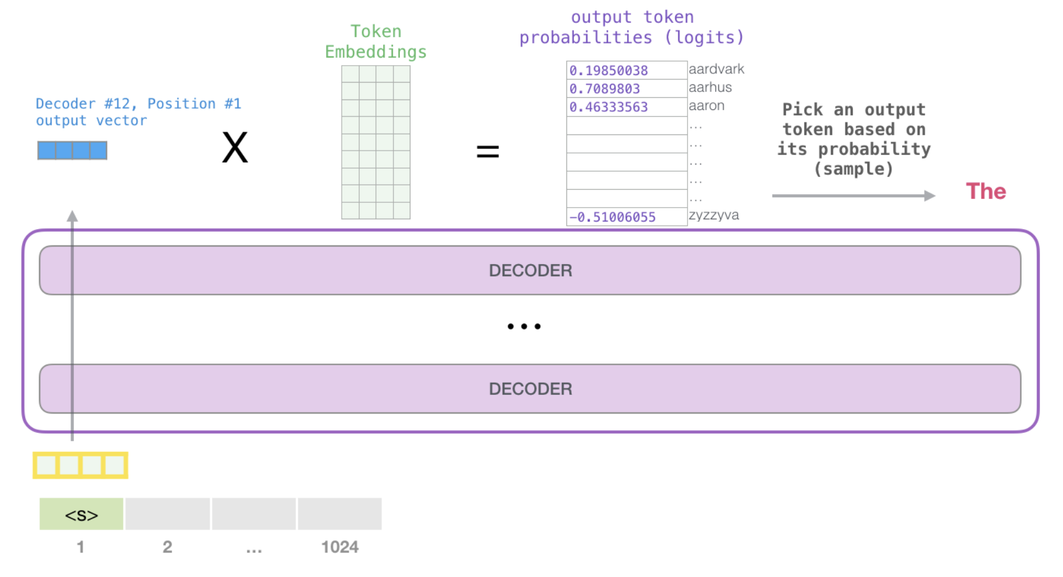
The Transformer Architecture:
Prediction
Finally, compare the final embedding against all token embeddings

Slide 12
The Transformer Architecture:
Prediction
Finally, compare the final embedding against all token embeddings
Obtain scores over next token candidates and convert to probabilities

Slide 13
Training an LLM: Optimization
Now we can compute the LLM’s guess for p(next token | previous tokens) How can we improve the model?
Check the probability of the correct token and move the model parameters a tiny bit to make the correct token more likely (stochastic gradient descent)
How do we know which parameters need to change? ⇒ Can compute the gradient of each parameter.
Always consider a batch of 10³-10⁶ of predictions and average gradients. ⇒ Parameters move to produce the best effect overall.
🔁 Repeat millions of times.

Slide 14
Training a LLM: Optimization
Now we can compute the LLM’s guess for p(next token | previous tokens) How can we improve the model?
Check the probability of the correct token and move the model parameters a tiny bit to make the correct token more likely (stochastic gradient descent)
How do we know which parameters need to change? ⇒ Can compute the gradient of each parameter.
Always consider a batch of 10³-10⁶ of predictions and average gradients. ⇒ Parameters move to produce the best effect overall.
🔁 Repeat millions of times.

Slide 15
Training a LLM: Optimization
Now we can compute the LLM’s guess for p(next token | previous tokens) How can we improve the model?
Check the probability of the correct token and move the model parameters a tiny bit to make the correct token more likely (stochastic gradient descent)
How do we know which parameters need to change? ⇒ Compute the gradient of each parameter.
Always consider a batch of 10³-10⁶ of predictions and average gradients. ⇒ Parameters move to produce the best effect overall.
🔁 Repeat millions of times.

Slide 16
Training a LLM: Optimization
Now we can compute the LLM’s guess for p(next token | previous tokens) How can we improve the model?
Check the probability of the correct token and move the model parameters a tiny bit to make the correct token more likely (stochastic gradient descent)
How do we know which parameters need to change? ⇒ Can compute the gradient of each parameter.
Always consider a batch of 10³-10⁶ of predictions and average gradients. ⇒ Parameters move to produce the best effect overall.
🔁 Repeat millions of times.

Slide 17
Training a LLM: Optimization
Now we can compute the LLM’s guess for p(next token | previous tokens)
How can we improve the model?
Check the probability of the correct token and move the model parameters a tiny bit to make the correct token more likely (stochastic gradient descent)
How do we know which parameters need to change? ⇒ Can compute the gradient of each parameter.
Always consider a batch of 10³ - 10⁶ of predictions and average gradients. ⇒ Parameters move to produce the best effect overall.
🔁 Repeat millions of times.

Slide 18
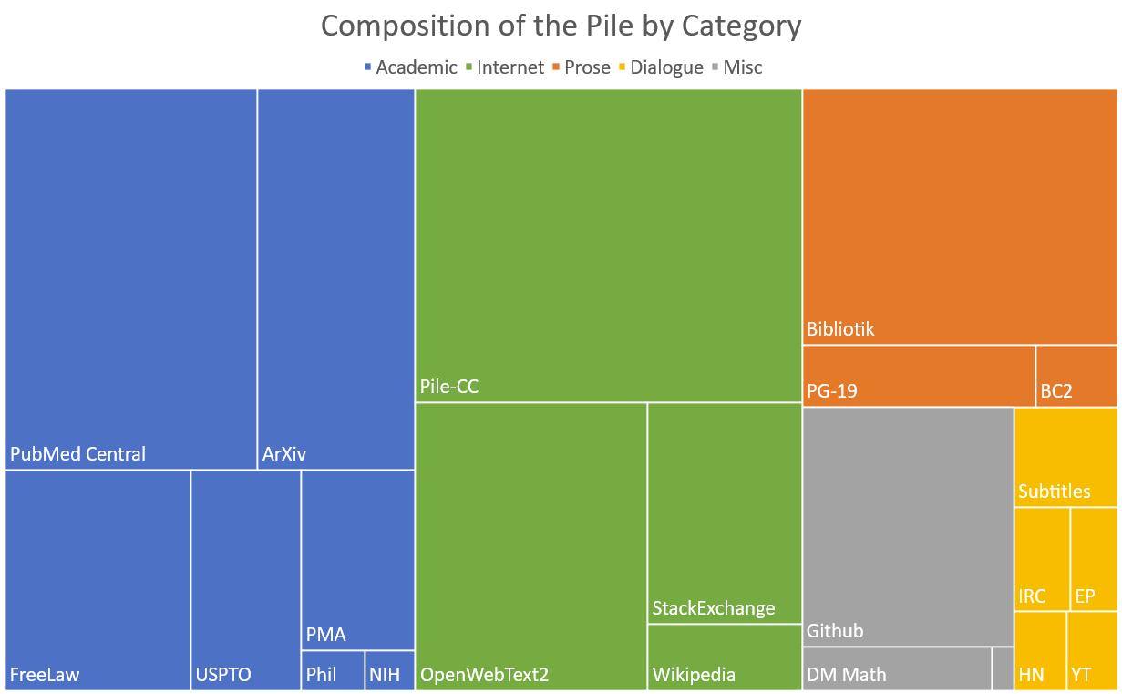
Training a LLM: Data
800GB of open-source data
[from Gao et al., The Pile: An 800GB Dataset of Diverse Text for Language Modeling]

Slide 19
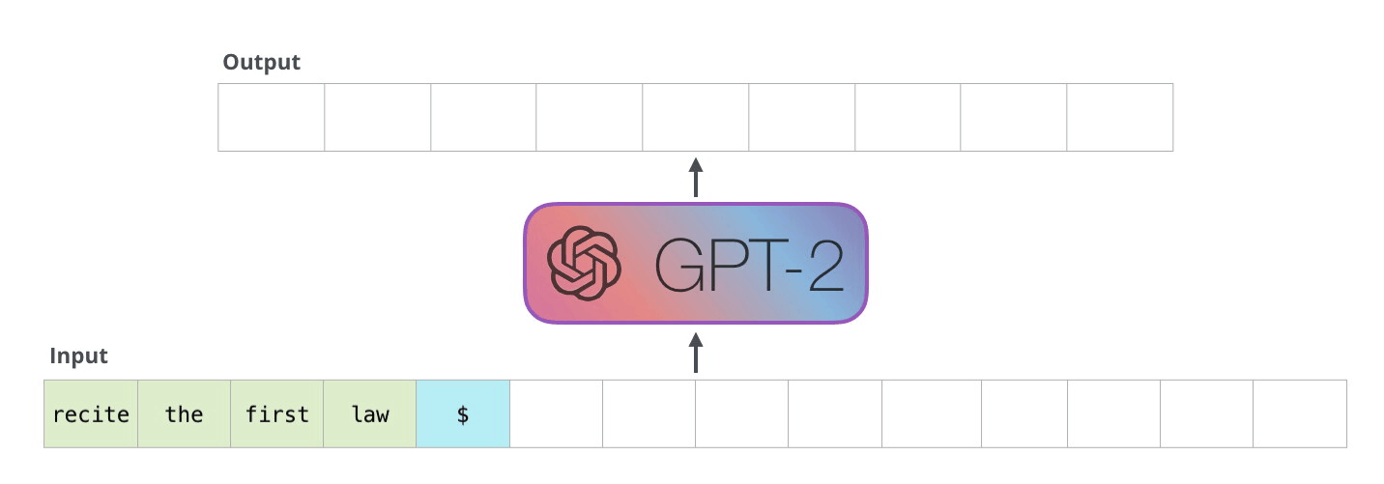
Text Generation
Sample a token from ~ p(next token | previous tokens)
Append the token to the input
Run the new input through the transformer
… and so on…
[from Alammar, The Illustrated GPT-2, https://jalammar.github.io/illustrated-gpt2/]

Slide 20
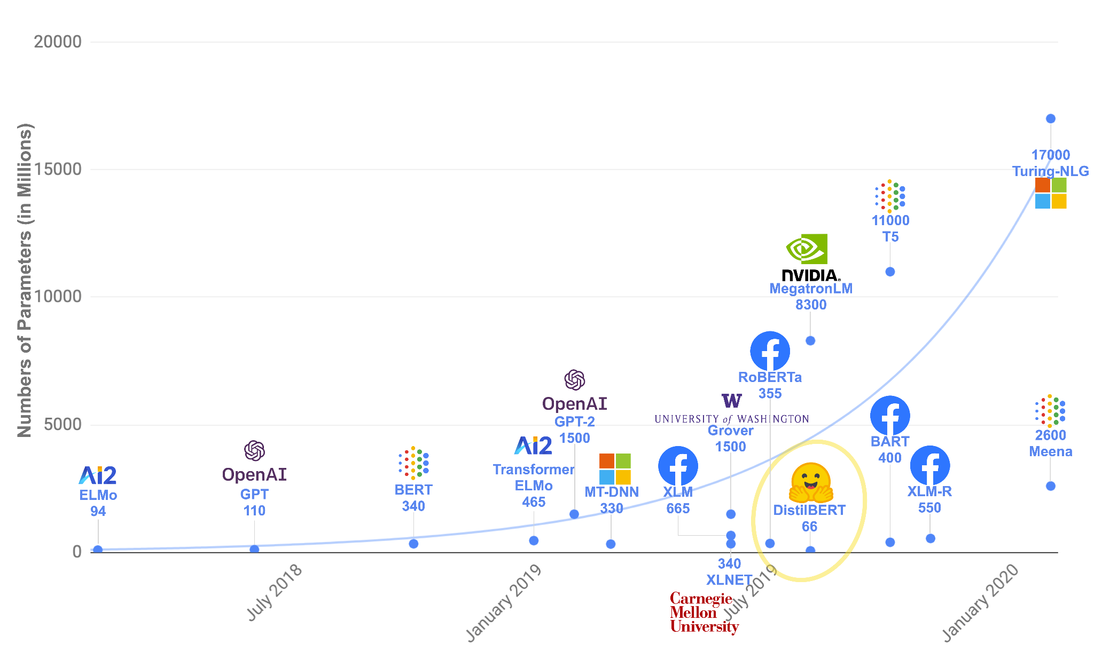
Scaling Up
[adapted from https://huggingface.co/course/chapter1/4]

Slide 21
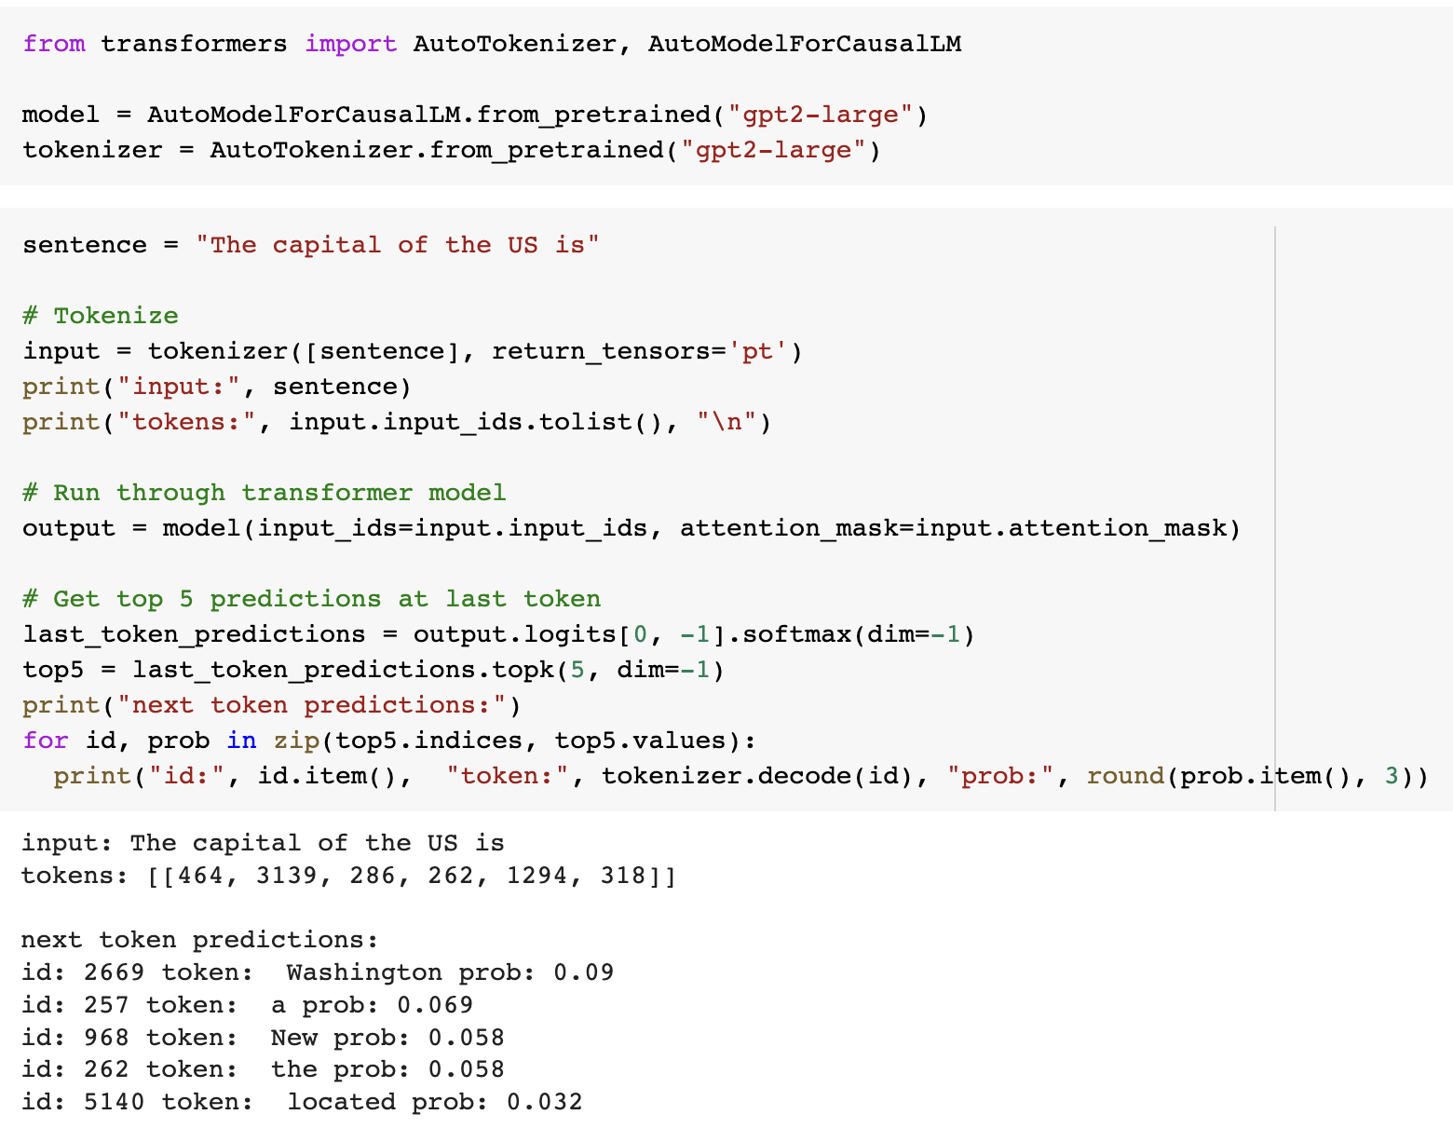
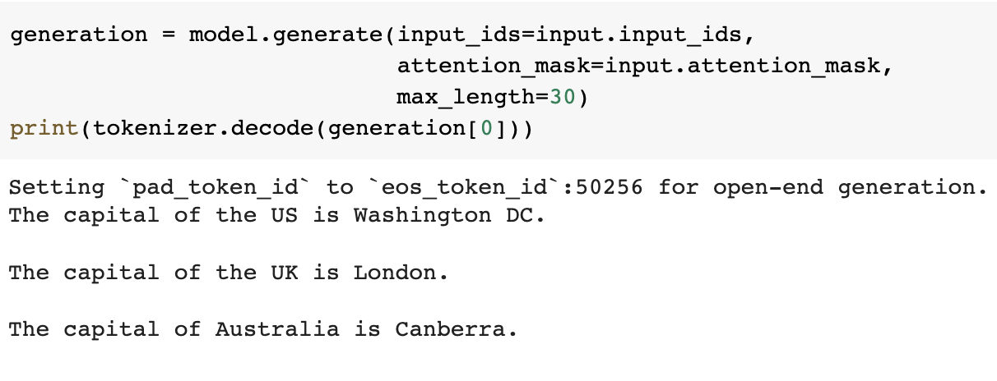
Resources for Coding
Huggingface transformers library:
Check out https://huggingface.co/course

Slide 22
Part II: Interacting with LLMs and ChatGPT

Slide 23
Framing tasks as next-token prediction
LLMs are trained to predict the next token.
But how is that useful?
Many tasks conform to next token prediction!
“The plot was substandard, but it left a smile!”
What is the sentiment of above sentence? _________

Slide 24
Framing tasks as next-token prediction
LLMs are trained to predict the next token.
But how is that useful?
Many tasks conform to next token prediction!
“The plot was substandard, but it left a smile!”
What is the sentiment of above sentence? Positive

Slide 25
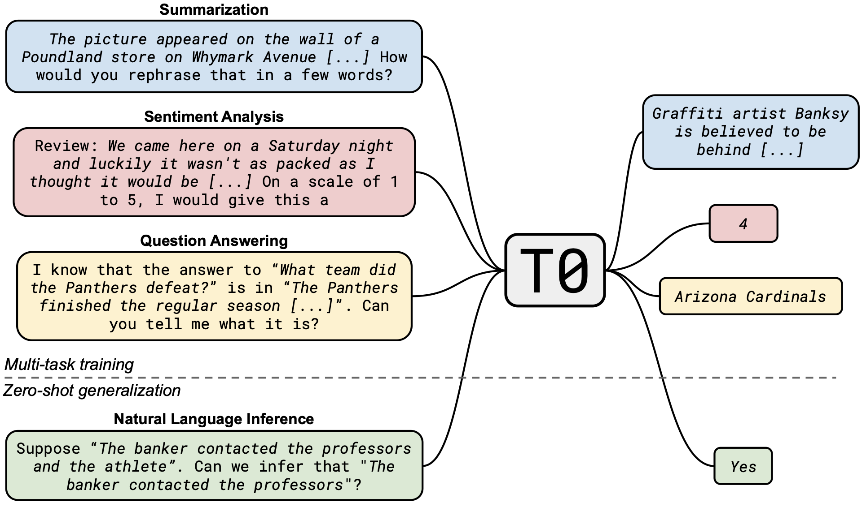
Framing tasks as next-token prediction
Tasks can similarly be framed as next-token prediction.
[Sanh et al., 2022: https://arxiv.org/pdf/2110.08207.pdf]

Slide 26
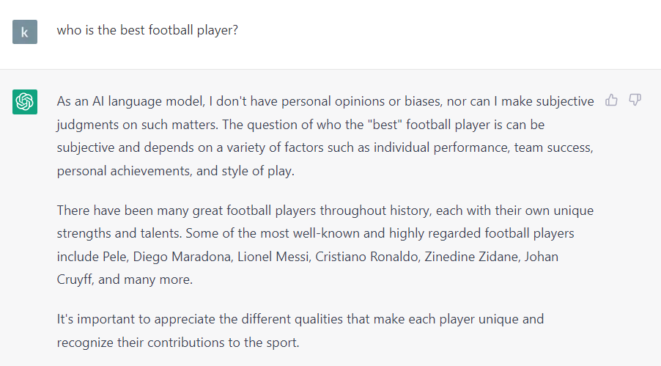
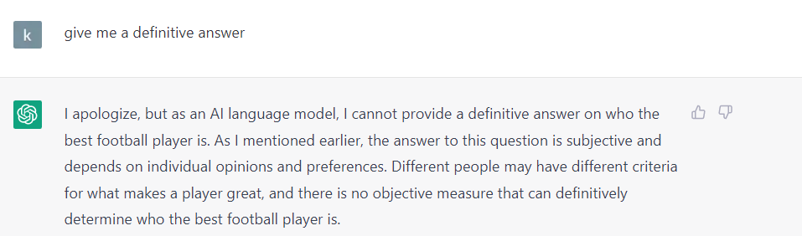
Aligning LLM responses with humans preferences
Both the responses are technically completions, but which one is better?

Slide 27
Aligning LLM responses with humans preferences
Thought experiment.
Consider the prompt - “Write a strongly worded email to your co-worker about their unfinished task”.
Consider the following responses:
The task is of extreme importance and I wish you took its completion seriously.
You are a terrible colleague and do not finish assigned tasks.
Which one would you prefer?
Even though there are multiple correct answers, users have a preference.
How do we encode this preference in the LLM?

Slide 28

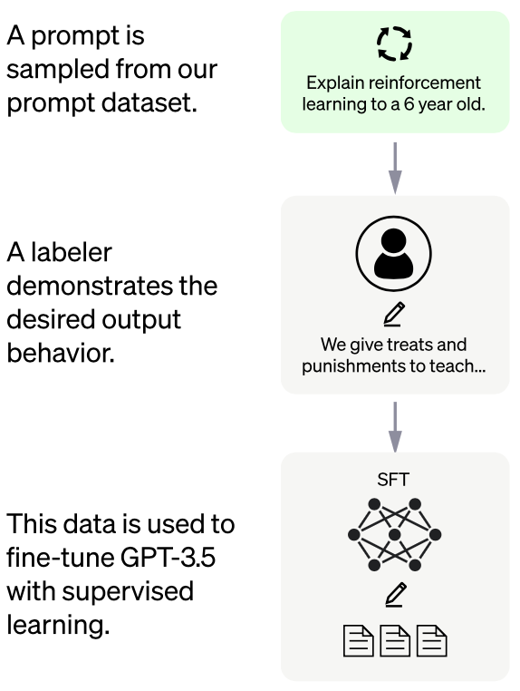
Aligning LLM responses with humans preferences

Slide 29
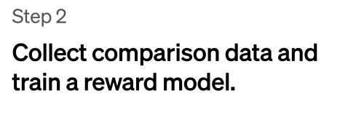
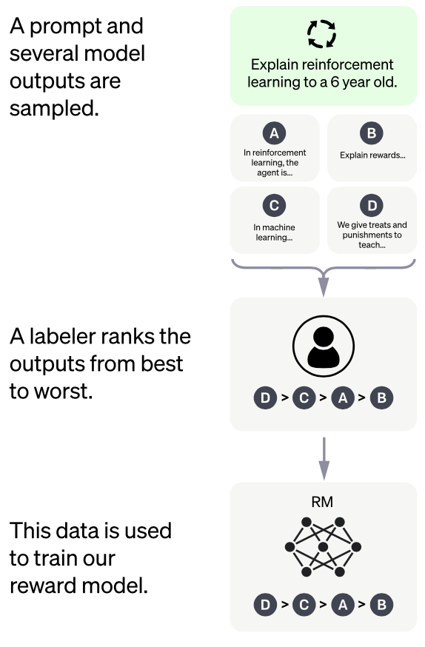
Aligning LLM responses with humans preferences

Slide 30
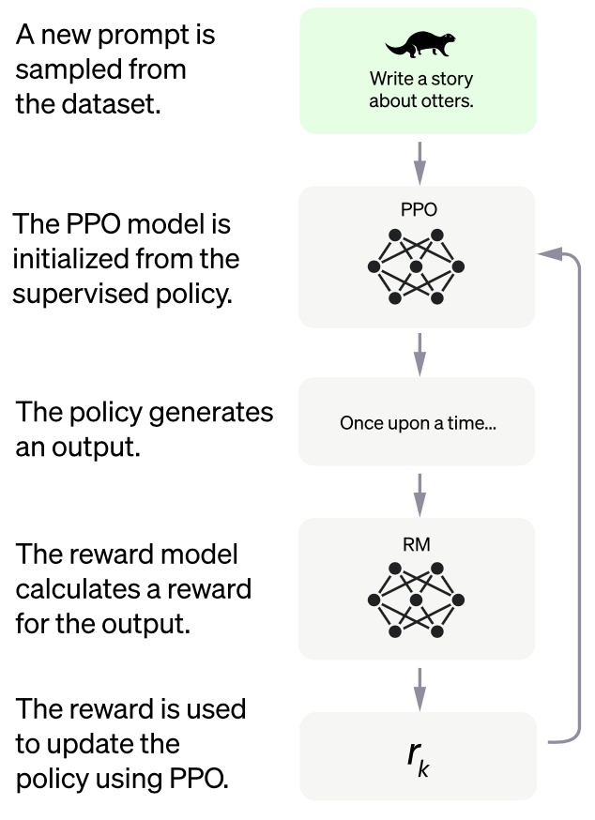
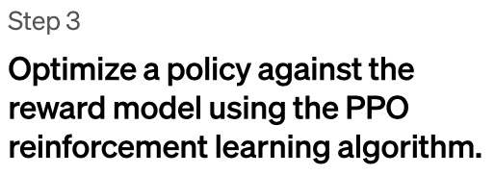
Aligning LLM responses with humans preferences

Slide 31
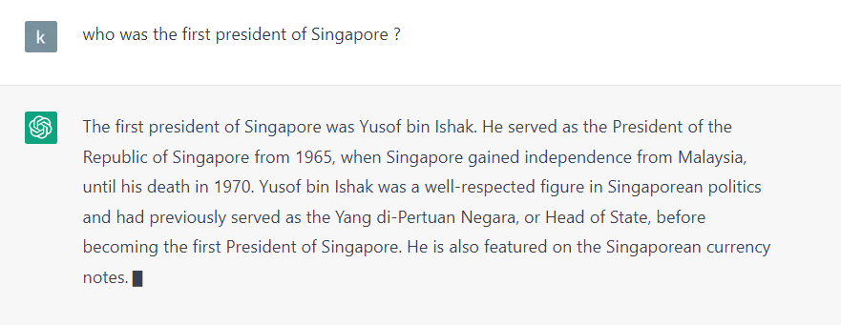
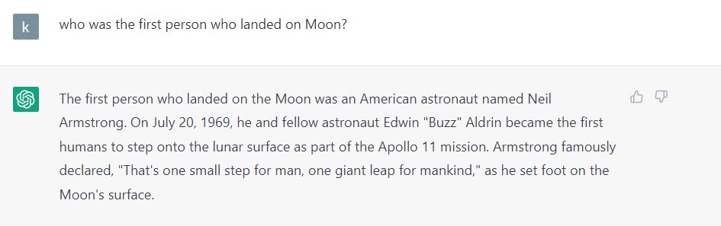
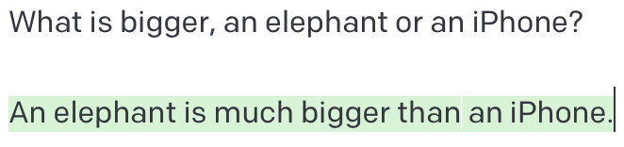
ChatGPT as a knowledge retriever

Slide 32
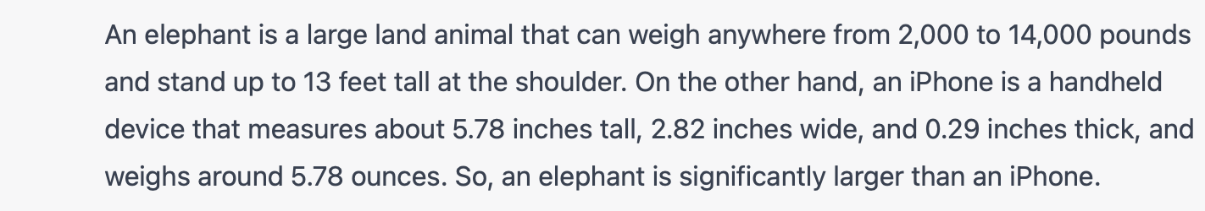
Reasoning capability of ChatGPT
ChatGPT can answer knowledge based questions, but what about questions which require reasoning?

Slide 33
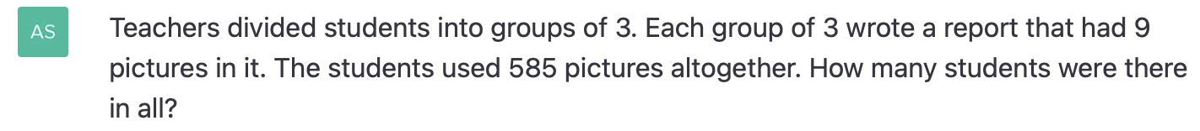
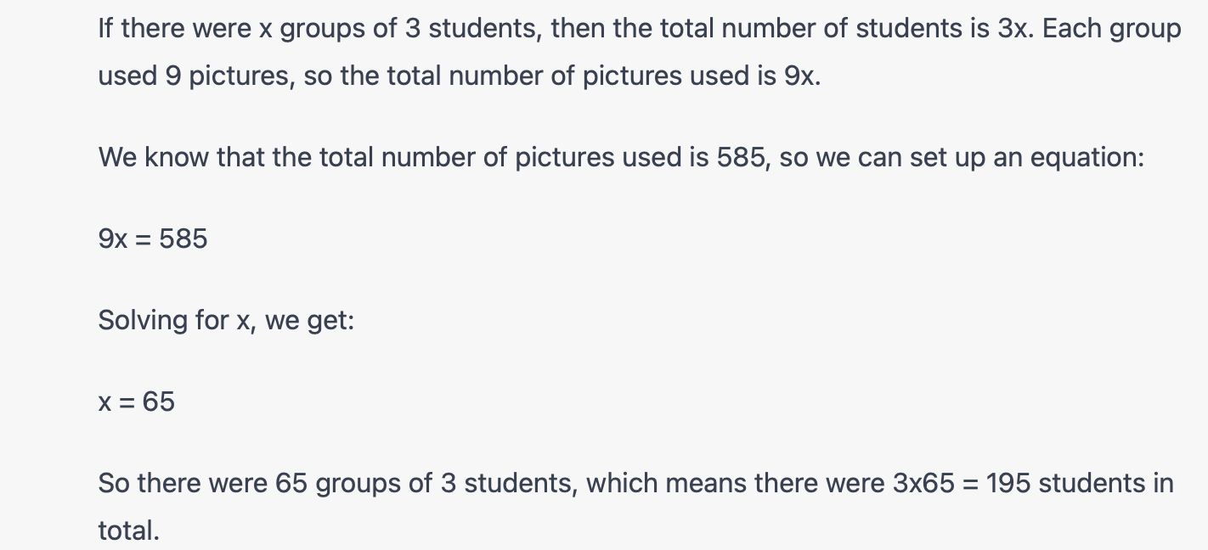
Mathematical reasoning (not very good here)

Slide 34
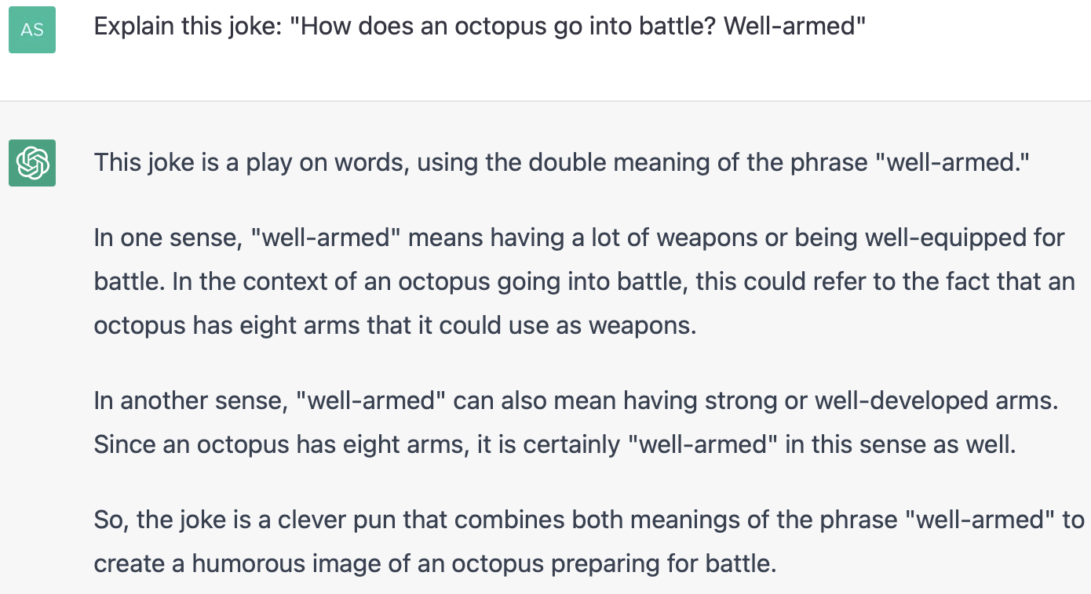
Reasoning about humor

Slide 35
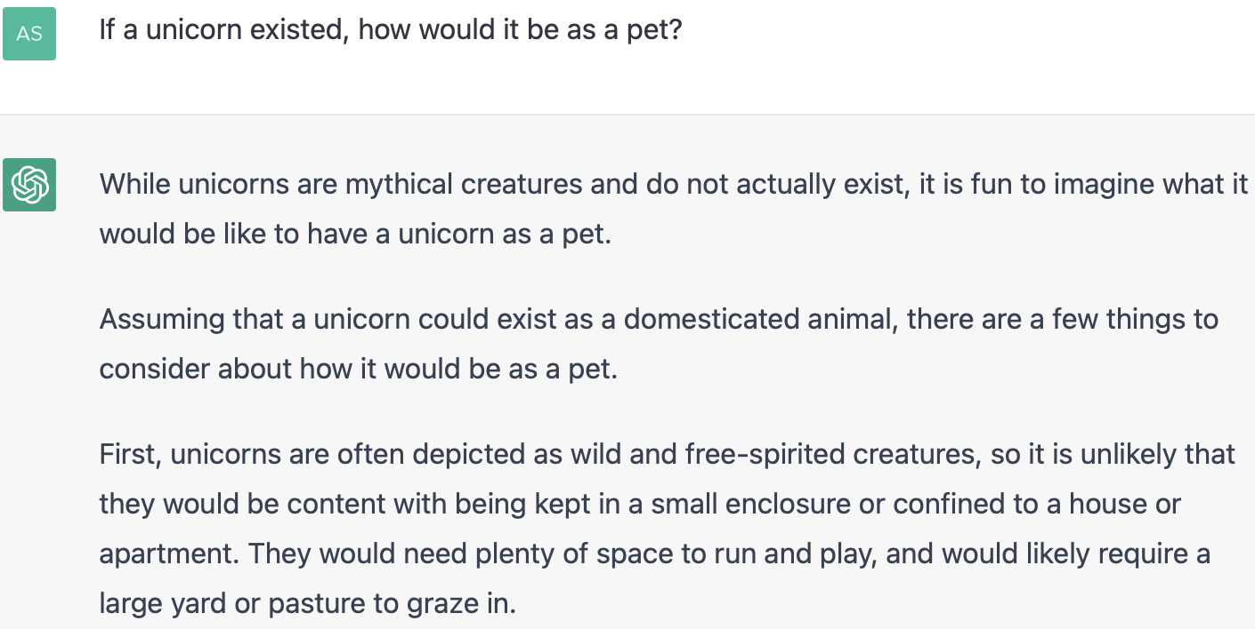
Hypothetical reasoning

Slide 36
ChatGPT for creative tasks
Writing essays and emails.
Paraphrasing or summarizing.
Explaining large amounts of information.
Creating complicated prompts
Notes:
Creativity: Most likely many correct ways of solving problems.

Slide 37
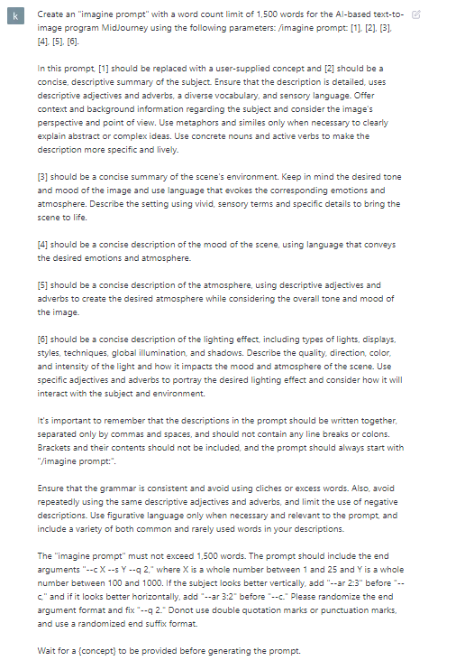
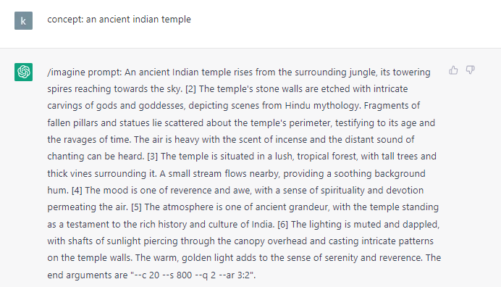

Create amazing images
Try this in Midjourney

Slide 38
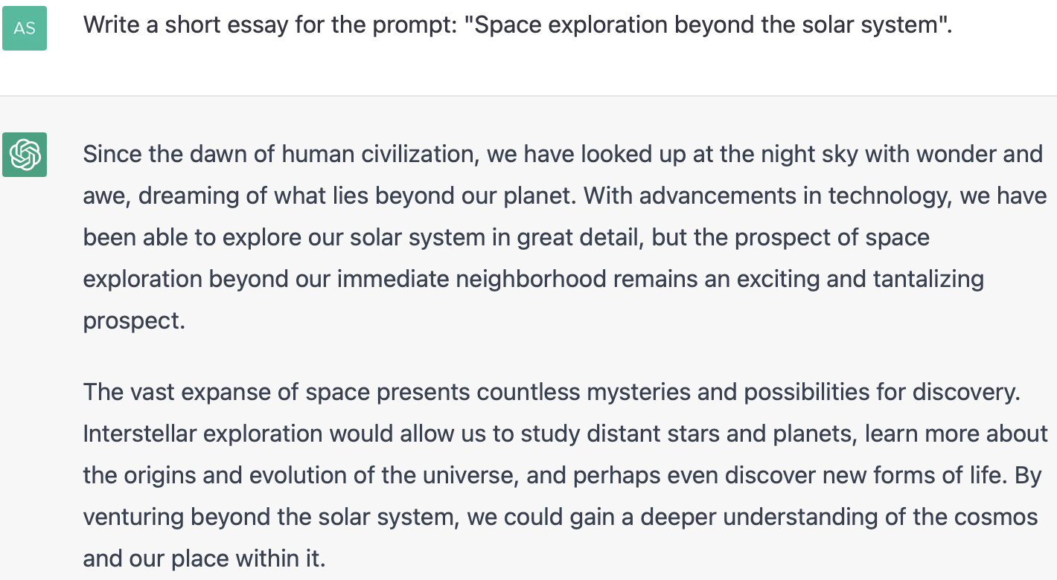
ChatGPT for creative tasks: Writing essays
Notes:
Creativity: Most likely many correct ways of solving problems.

Slide 39
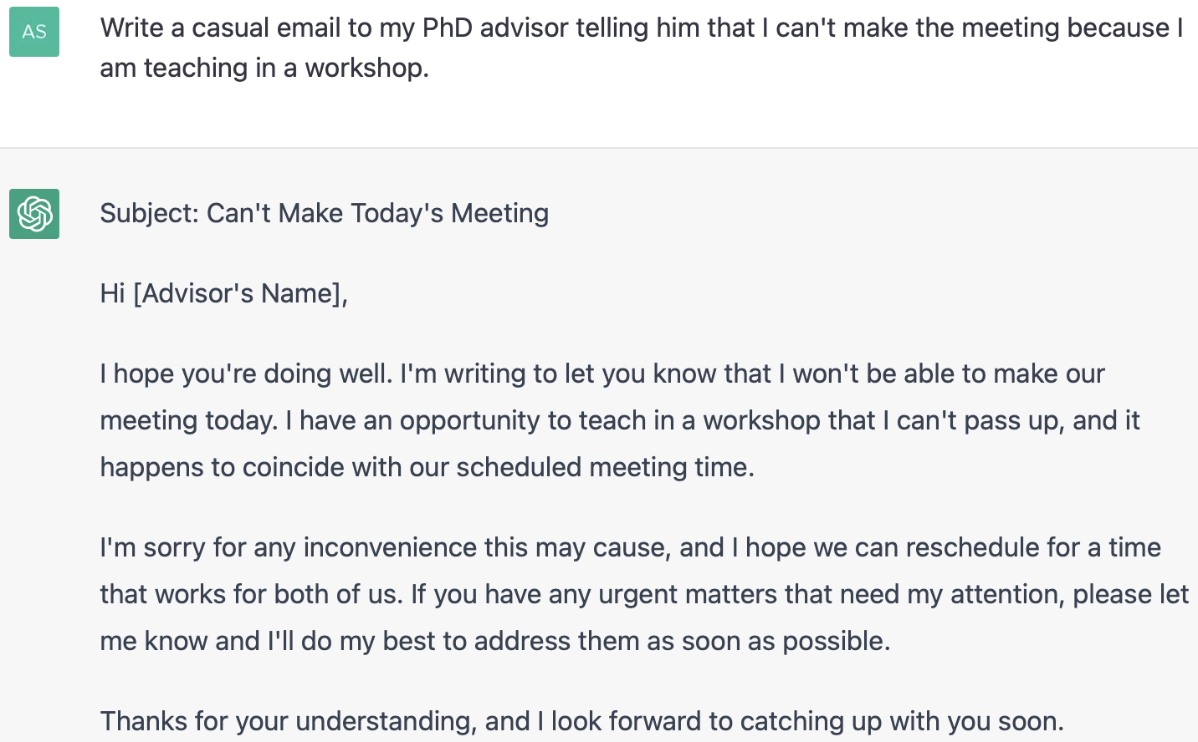
ChatGPT for creative tasks: Writing drafts
Notes:
Creativity: Most likely many correct ways of solving problems.

Slide 40
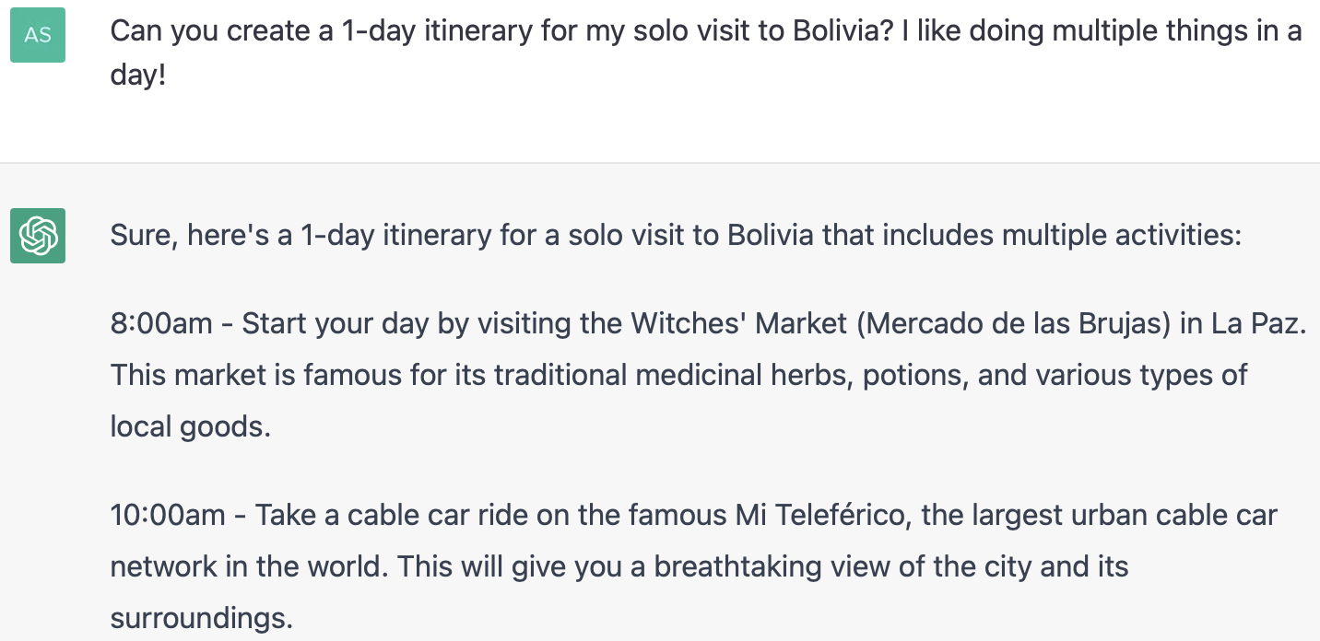
ChatGPT for creative tasks: Creating itineraries
Notes:
Creativity: Most likely many correct ways of solving problems.

Slide 41
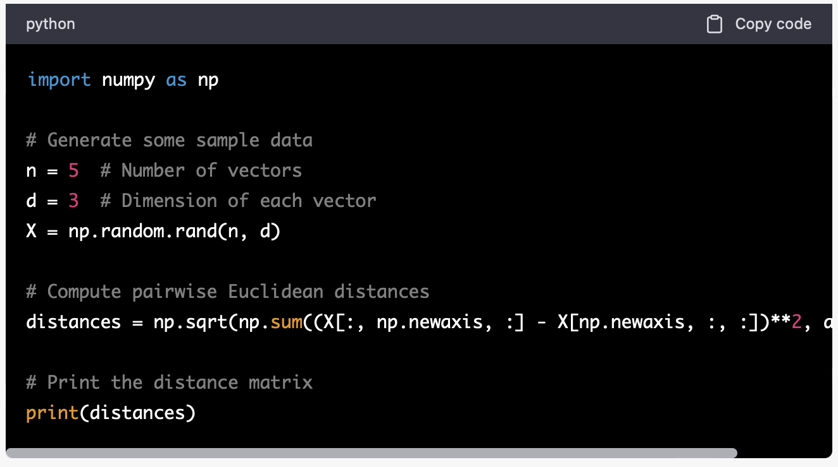
ChatGPT for code
Notes:
Creativity: Most likely many correct ways of solving problems.

Slide 42
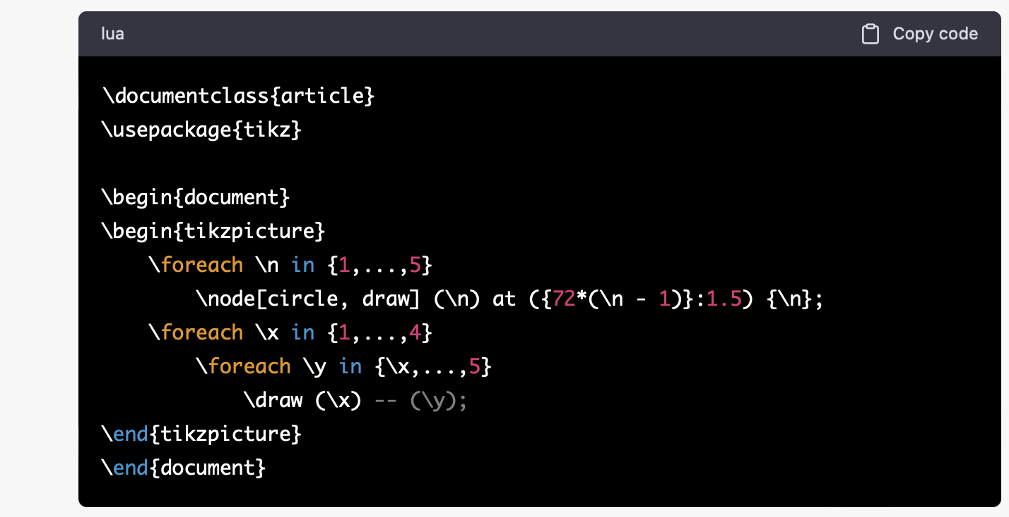
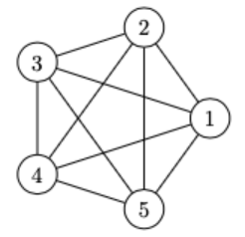
ChatGPT for code
Notes:
Creativity: Most likely many correct ways of solving problems.

Slide 43
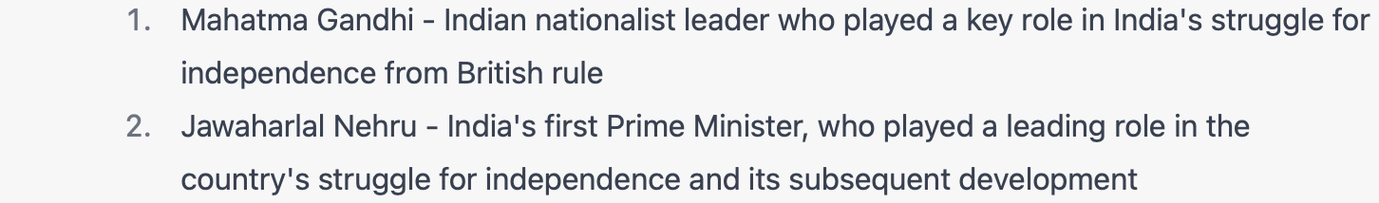
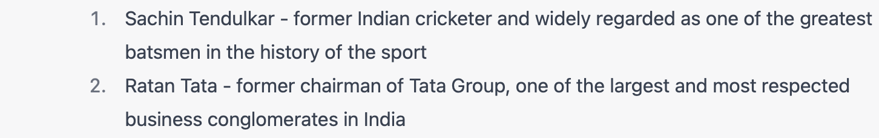
Dialogue: Incorporating history into models

Slide 44
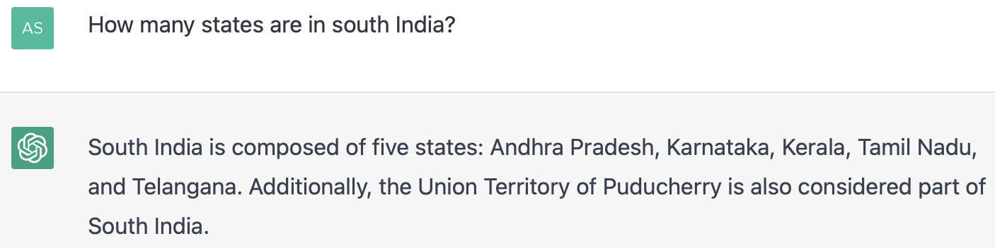
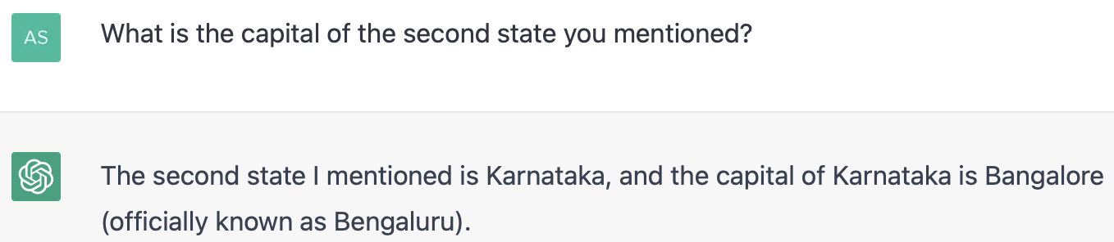
Dialogue: How does it work?
GPT-3 is fine-tuned for next-token prediction on dialogue datasets, so it learns to produce the next utterance for a user query.
So how they do is, they take the first 3 chunks as inputs and then
Predict the last chunk

Slide 45
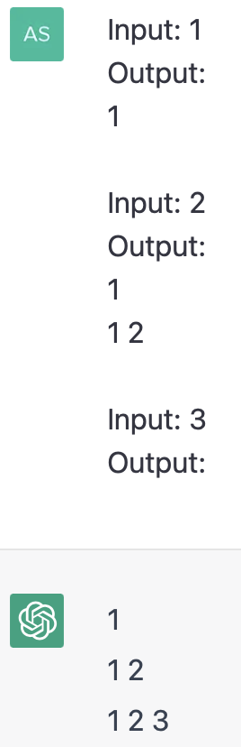
In-context learning
Can LLMs solve novel tasks not seen during training?
Or answer questions in a certain style?
Demonstrations

Slide 46
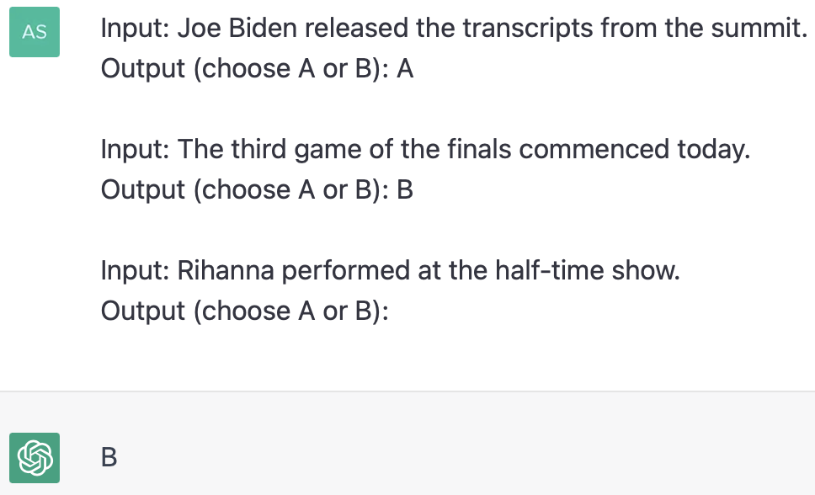
In-context learning
Can LLMs extrapolate from demonstrations?
So this is a good way of teaching Chat GPT with demonstrations instead of
instructions
ChatGPT understands that:
A = politics
B = sports

Slide 47
Part III: Potential limitations of ChatGPT

Slide 48
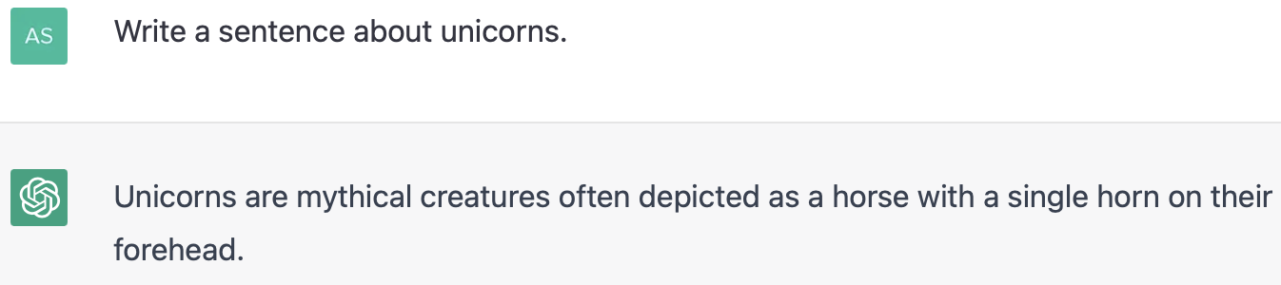
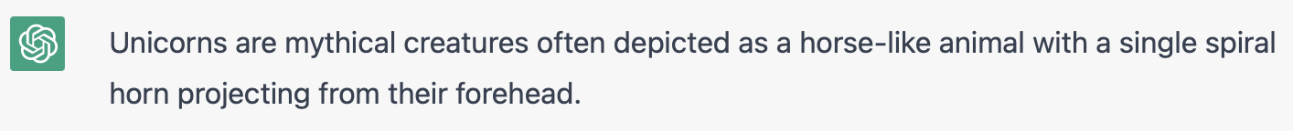
Outputs are probabilistic

Slide 49
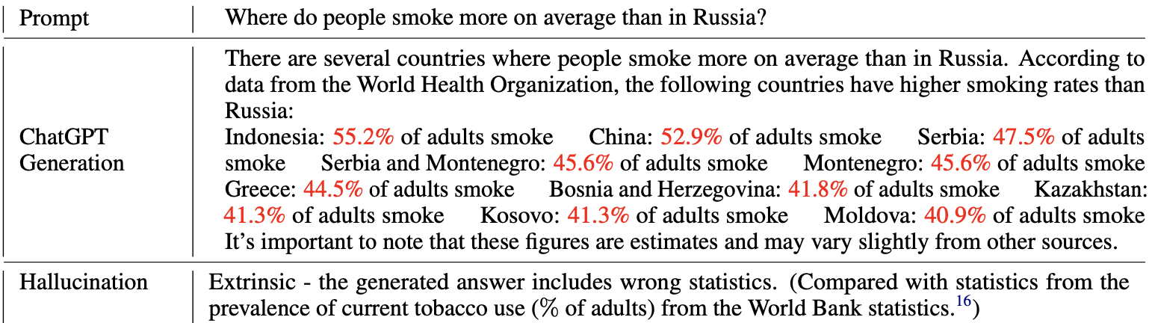
ChatGPT can hallucinate
Numbers marked in red are wrong, ChatGPT imagines them.
[Bang et al., 2023:https://arxiv.org/pdf/2302.04023.pdf]

Slide 50
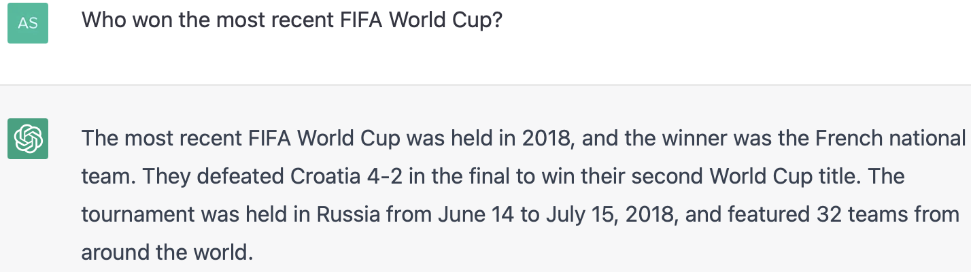
ChatGPT has a timestamp
The answer should have been Argentina, but it is not always trained on the most recent data.

Slide 51
https://www.youtube.com/watch?v=flXrLGPY3SU&t=8370s
What is ChatGPT doing.. And why does it work?
By Wolfram. This is a seminal video.
In 2009, Wolfram created Wolfram Alpha, a computational knowledge engine utilized by millions of users worldwide. His current focus is on the Wolfram Language, a powerful programming language designed to democratize access to cutting-edge technology. Wolfram's numerous accolades include honorary doctorates and fellowships from prestigious institutions. As an influential thinker, Dr. Wolfram has dedicated his life to unraveling the mysteries of the universe and making computation accessible to all.

Slide 52
Questions?

Slide 53
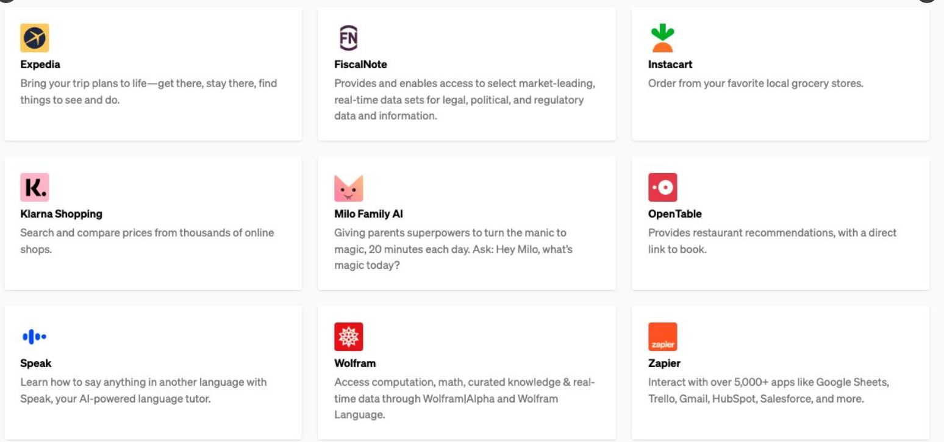
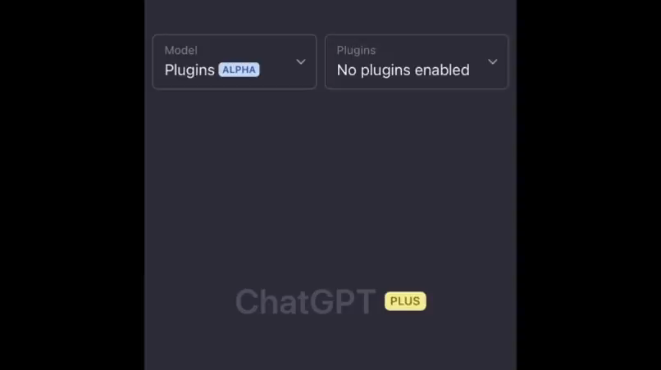
News on Chat GPT
OpenAI released plugins for ChatGPT.
Plugins for ChatGPT augment the language model's capability to:
• Access up-to-date information
• Run computations
• Use third-party services
This will unlock use cases that shape the future of human-AI interaction.
Collaborations with major companies
Here's an example of meal planning for your weekend:
• Restaurant recommendation for Saturday (OpenTable)
• Recipe for Sunday (ChatGPT)
• Calculate calories (WolframAlpha)
• Order the ingredients (Instacart)

Slide 54


OpenAI's browser plugin ChatGPT can now access information from the internet beyond its training data.
• Uses the Bing API to search
• Synthesises information across multiple sources
• References sources with click-throughs to verify claims
Code interpreter plugin for Python An experimental code interpreter allows ChatGPT to use Python in a secure environment.
• Solves mathematical problems
• Data analysis and visualisation
• File format conversion
This will make coding more accessible to everyone.

Slide 55


Slide 56

Github Copilot

